Slide 1


AGE 219: File Handling
and Data Persistence
School of Engineering and Technology (SoET)
Dr. Kadeghe Fue, PhD, P.Eng (T)
AI & Robotics Specialist | Office: EPAL

Slide 2


Recap: Lecture 6 Data Structures
We mastered organizing data in RAM using Lists, Tuples, and Dictionaries for complex information mapping.

Slide 3


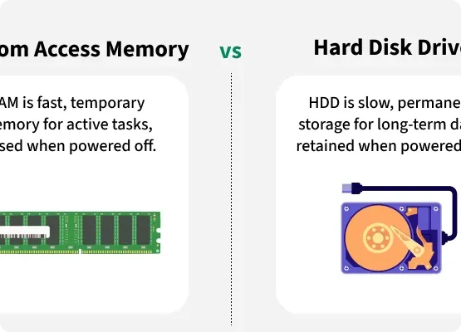
Concept of Persistence
Volatility vs. Persistence
RAM (Volatile): Fast but temporary. Data is lost when the script ends or power cuts.
Disk (Persistent): Slower but permanent. Data survives restarts and power outages.
In AGE 219, we now move from temporary calculations to permanent data logging.

Slide 4
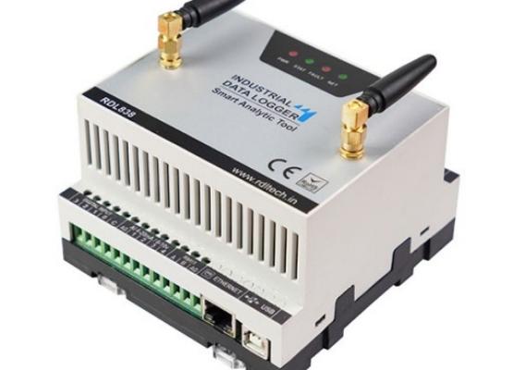
Files in Agri-Informatics
Real-World Engineering
Agricultural engineers rarely type data manually. They process logs from sensors.
SD Cards: Storing field sensor data.
Telemetry: Machinery logs exported from tractors.
Reports: Generating daily irrigation summaries.

Slide 5








Common File Formats
Text (.txt)
CSV (.csv)
JSON (.json)
Plain human-readable logs and simple notes.
The "Gold Standard" for sensor data and spreadsheets.
Standard for machine-to-machine IoT communication.

Slide 6


1. Basic File I/O
The Open → Process → Close Workflow

Slide 7

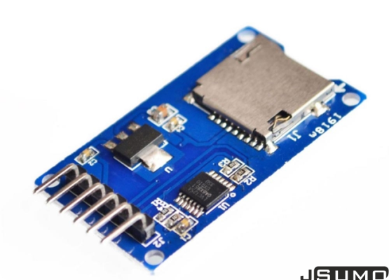

The open() Function
Opening a Portal
To access a file, Python creates a "File Object."
Requires the filename and the mode (what you want to do).

Slide 8

Standard File Modes
Mode | Name | Logic / Behavior
"r" | Read | Opens for reading. (Error if file doesn't exist)
"w" | Write | Opens for writing. (Overwrites existing content!)
"a" | Append | Adds data to the end of the file. (Keeps existing)
"x" | Create | Creates file. (Error if file already exists)

Slide 9
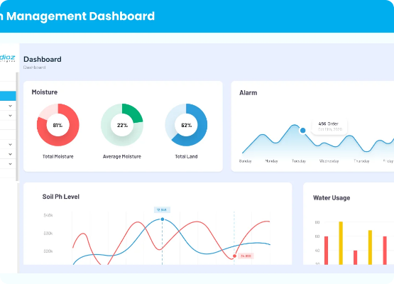

Writing to Text Files
Exporting Data
Use f.write() to send strings to the file.
Note: \n is essential for creating new lines.

Slide 10
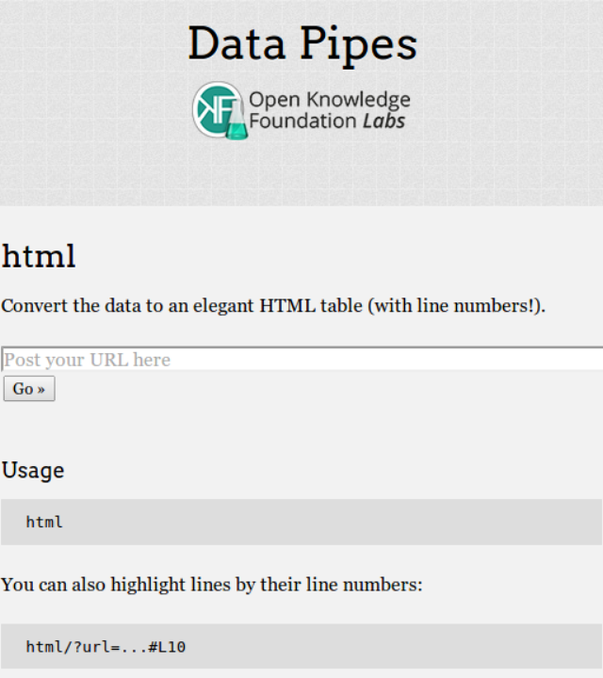
Reading Files
Importing Data
Multiple methods to pull content from storage into variables:
f.read(): Entire file as one string.
f.readline(): One line at a time.
f.readlines(): Entire file into a List.

Slide 11


2. Professional Standards
Safety, Cleanliness, and the "with" statement.

Slide 12


The Context Manager
Why use "with"?
Manually closing (f.close()) is risky. If an error occurs, the file stays open, leaking memory and locking the file.
The with keyword automatically closes the file even if the program crashes.

Slide 13

Automatic Safety
100%
Professional Syntax
Closure Accuracy
This is the only way we will handle files in SoET projects.

Slide 14
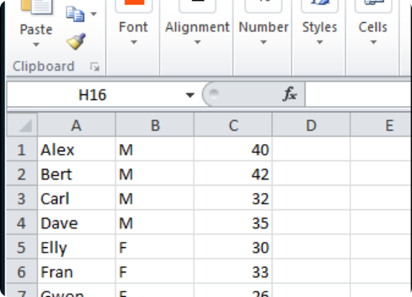
Tabular Data: CSV
Spreadsheets for Machines
CSV (Comma Separated Values) is a text-based representation of a table.
Format: Headers are the first row, data follows line by line.
Used for: Weather history, crop yields, and GPS trails.

Slide 15


The csv Module
Why not use split(",")?
Real-world data is messy (commas inside quotes, missing fields). Manual splitting will fail.
Python's import csv handles all edge cases and headers automatically.

Slide 16
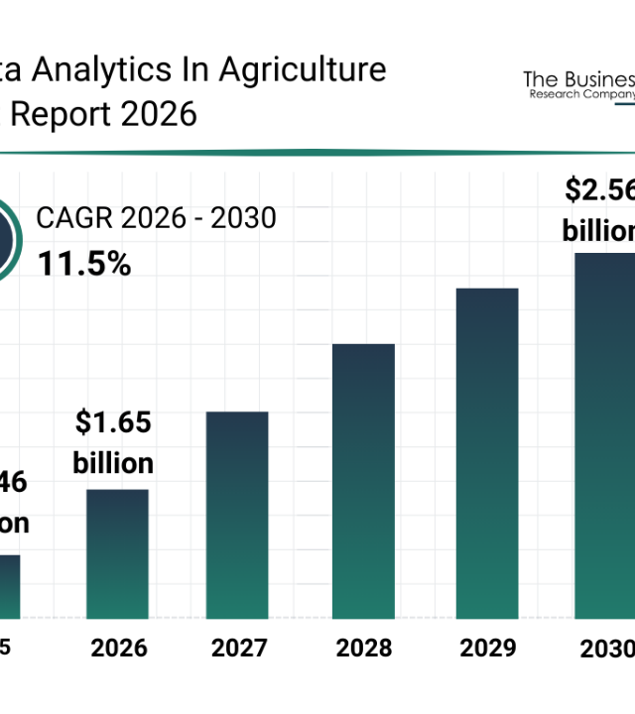

CSV DictReader
Mapping Headers to Logic
The DictReader class converts each row of a CSV into a Python Dictionary.
This allows us to access columns by Name instead of position.

Slide 17


Robust Engineering
Handling Missing Files
In autonomous systems, if a sensor log is missing, the program shouldn't crash.
We use try...except to catch FileNotFoundError and provide default settings or log a warning.

Slide 18




File Path Logic
Relative Path
Absolute Path
"logs/temp.txt"
Target file relative to where the script is running.
"/content/drive/MyData.csv"
The full precise location in the system.

Slide 19
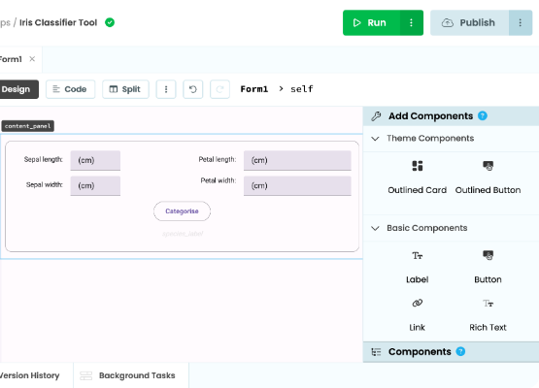

Colab & Cloud Storage
Accessing External Files
Upload: Side pane upload (temporary).
Drive Mount: Persistent linkage to your Google Drive.

Slide 20
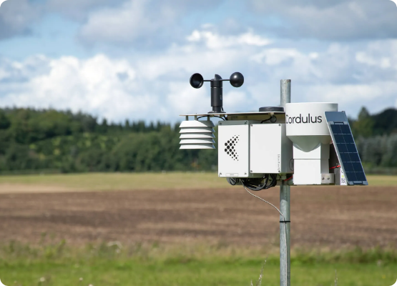
Case Study: 24hr Monitor
Automated Alert System
Goal: Scan a 24-hour sensor log and find critical heat stress events.
1. Open "weather_log.csv".
2. Filter rows where temp > 35.0.
3. Write the timestamps of these events to "alerts.txt".

Slide 21
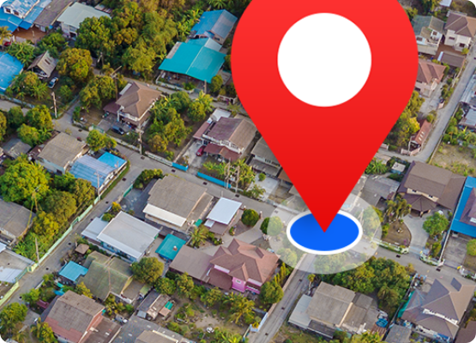
Case Study: GPS Log Export
Path Planning Data
Autonomous tractors log their path as a series of coordinates.
We use Python to read these binary or CSV logs and generate a visual heatmap of field coverage or fuel efficiency.

Slide 22


Questions?
Thank you for your attention.
Next Lecture: Object Oriented Programming (OOP)
School of Engineering and Technology (SoET) | SUA Morogoro

